Slide 1
AVL TREE

Slide 2
AVL Trees
AVL tree is a self-balancing binary search tree in which the heights of the two sub-trees of a node may differ by at most one. Because of this property, AVL tree is also known as a height-balanced tree.
The key advantage of using an AVL tree is that it takes O(logn) time to perform search, insertion and deletion operations in average case as well as worst case (because the height of the tree is limited to O(logn)).
The structure of an AVL tree is same as that of a binary search tree but with a little difference. In its structure, it stores an additional variable called the Balance Factor.

Slide 3
AVL Trees
The balance factor of a node is calculated by subtracting the height of its right sub-tree from the height of its left sub-tree.
Balance factor = Height (left sub-tree) – Height (right sub-tree)
A binary search tree in which every node has a balance factor of -1, 0 or 1 is said to be height balanced. A node with any other balance factor is considered to be unbalanced and requires rebalancing.
If the balance factor of a node is 1, then it means that the left sub-tree of the tree is one level higher than that of the right sub-tree. Such a tree is called Left-heavy tree.
If the balance factor of a node is 0, then it means that the height of the left sub-tree is equal to the height of its right sub-tree.
If the balance factor of a node is -1, then it means that the left sub-tree of the tree is one level lower than that of the right sub-tree. Such a tree is called Right-heavy tree.

Slide 4
AVL Trees
Left heavy AVL tree
45
1
Balanced AVL tree
1
45
0
36
63
0
0
36
63
0
1
27
0
0
39
54
72
0
0
0
27
39
54
72
0
18
0
0
Right heavy AVL tree
45
-1
0
-1
36
63
0
0
0
1
27
39
54
72
70
0

Slide 5
Searching for a Node in an AVL Tree
Searching in an AVL tree is performed exactly the same way as it is performed in a binary search tree.
Because of the height-balancing of the tree, the search operation takes O(log n) time to complete.
Since the operation does not modify the structure of the tree, no special provisions need to be taken.

Slide 6
Inserting a Node in an AVL Tree
Since an AVL tree is also a variant of binary search tree, insertion is also done in the same way as it is done in case of a binary search tree.
Like in binary search tree, the new node is always inserted as the leaf node. But the step of insertion is usually followed by an additional step of rotation.
Rotation is done to restore the balance of the tree. However, if insertion of the new node does not disturb the balance factor, that is, if the balance factor of every node is still -1, 0 or 1, then rotations are not needed.

Slide 7
Inserting a Node in an AVL Tree
During insertion, the new node is inserted as the leaf node, so it will always have balance factor equal to zero.
The nodes whose balance factors will change are those which lie on the path between the root of the tree and the newly inserted node.
The possible changes which may take place in any node on the path are as follows:
Initially the node was either left or right heavy and after insertion has become balanced.
Initially the node was balanced and after insertion has become either left or right heavy.
Initially the node was heavy (either left or right) and the new node has been inserted in the heavy sub-tree thereby creating an unbalanced sub-tree. Such a node is said to be a critical node.

Slide 8
Rotations to Balance AVL Trees
To perform rotation, our first work is to find the critical node. Critical node is the nearest ancestor node on the path from the root to the inserted node whose balance factor is neither -1, 0 nor 1.
The second task is to determine which type of rotation has to be done.
There are four types of rebalancing rotations and their application depends on the position of the inserted node with reference to the critical node.
LL rotation: the new node is inserted in the left sub-tree of the left sub-tree of the critical node
RR rotation: the new node is inserted in the right sub-tree of the right sub-tree of the critical node
LR rotation: the new node is inserted in the right sub-tree of the left sub-tree of the critical node
RL rotation: the new node is inserted in the left sub-tree of the right sub-tree of the critical node

Slide 9
AVL Tree Rotations
In AVL tree, after performing every operation like insertion and deletion we need to check the balance factor of every node in the tree.
If every node satisfies the balance factor condition then we conclude the operation
Otherwise we must make it balanced. We use rotation operations to make the tree balanced whenever the tree is becoming imbalanced due to any operation.

Slide 10
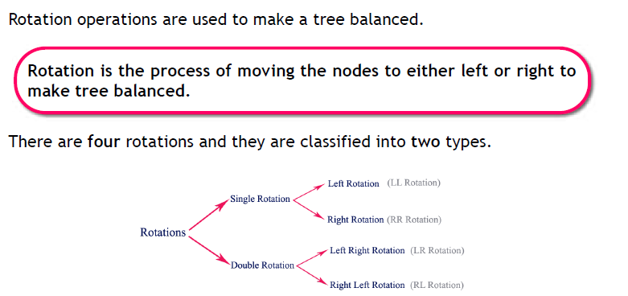

Slide 11
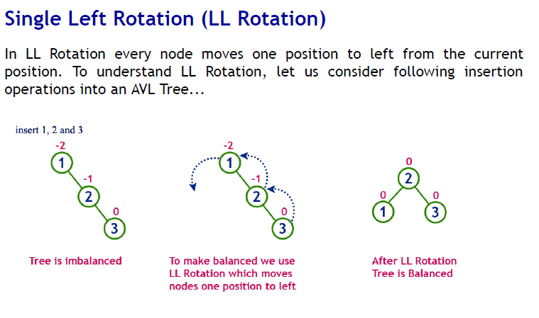

Slide 12

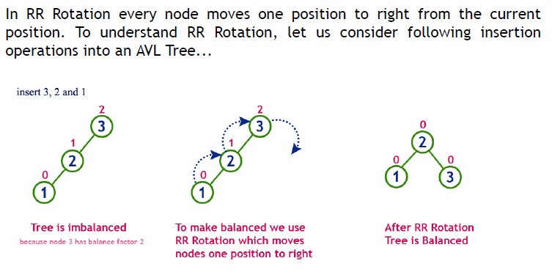

Slide 13
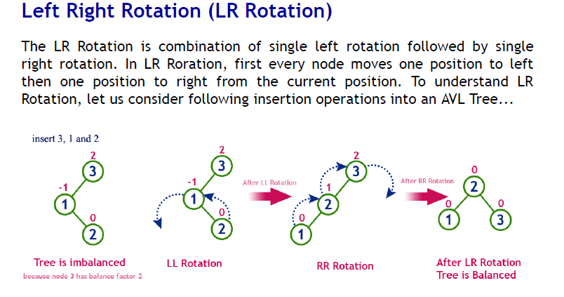

Slide 14
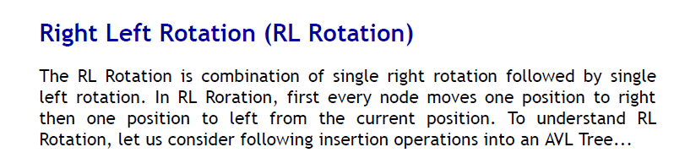
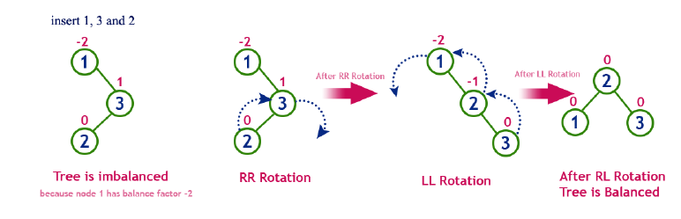

Slide 15
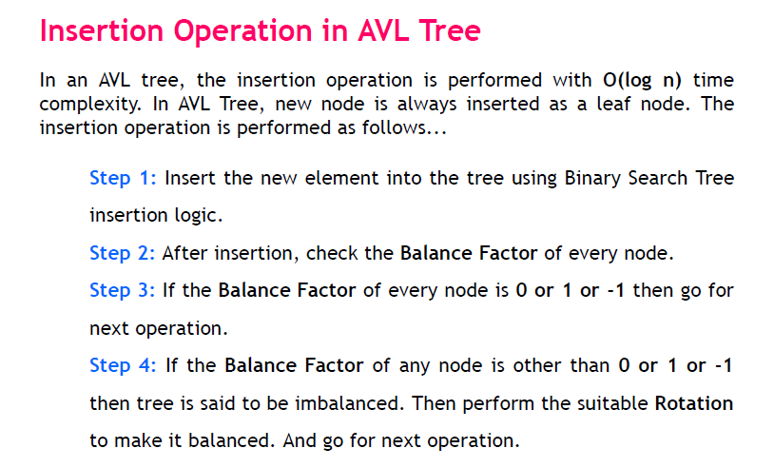

Slide 16
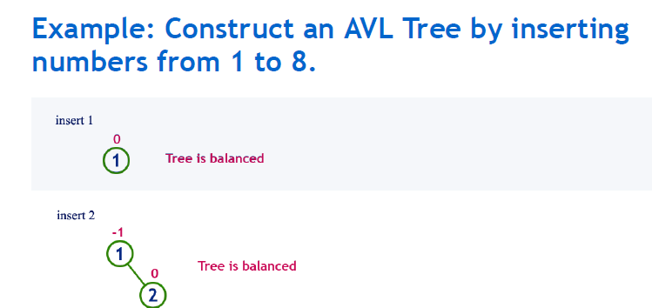

Slide 17
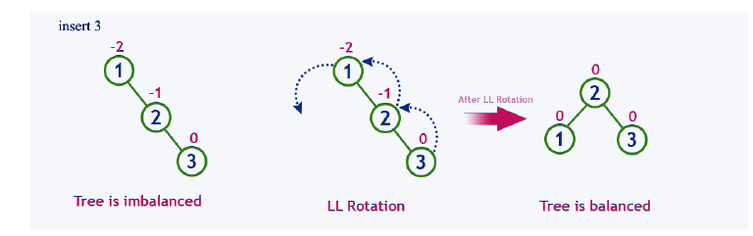

Slide 18
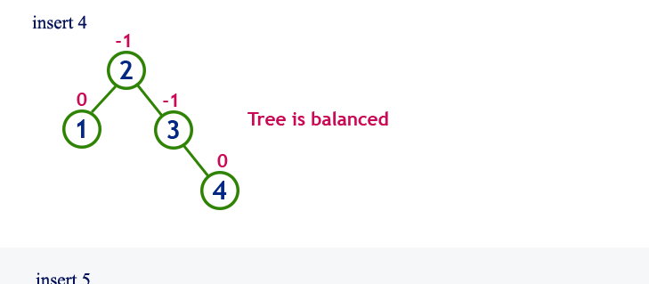

Slide 19
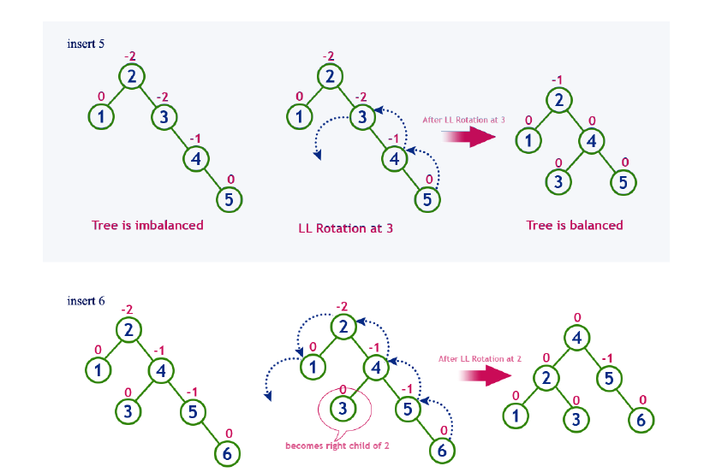

Slide 20
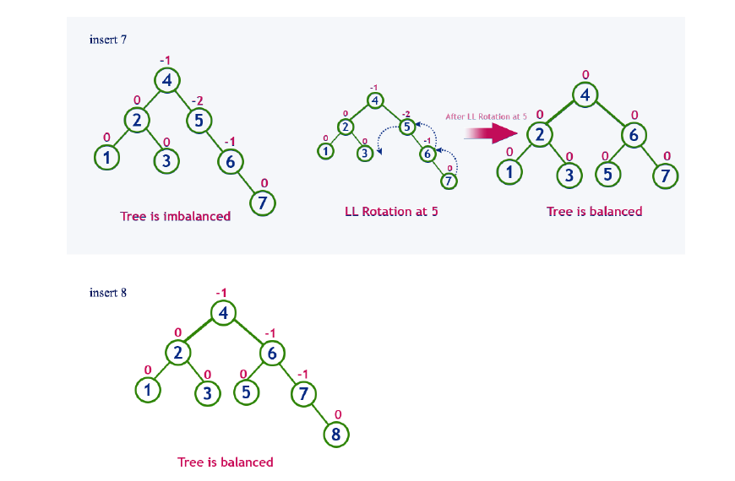

Slide 21
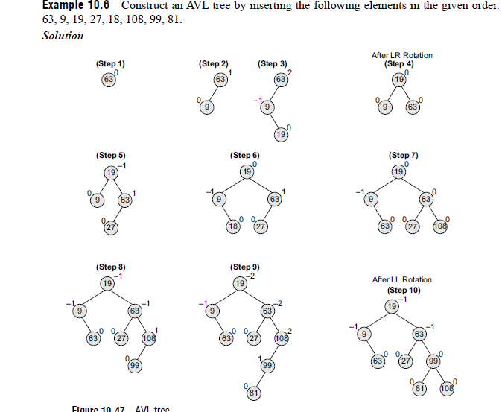

Slide 22
Deletion Operation in AVL Tree
Deletion Operation in AVL Tree
In an AVL Tree, the deletion operation is similar to deletion operation in BST.
But after every deletion operation we need to check with the Balance Factor condition.
If the tree is balanced after deletion then go for next operation otherwise perform the suitable rotation to make the tree Balanced.

